Slide 1

LEX/FLEX
Scanner Generator in C

Slide 2

Project Title
Presented By
Ahmed refaat 200017694
Yousef Atef 200016657
Ziad Abdelwahab 200013252
Mohamed Elshaer 200019118
Mostafa Arafa 200020784
Under Supervision
DR Nehal A. Mohamed
T.A Mariam Farird

Slide 3
Outline
Introduction
Phases of Compiler
Lexical Analyzer
Software Tools
Inputs of Scanner
Outputs of Scanner
Conclusion
References

Slide 4
Project Link
Github link
https://github.com/Usef3/Compiler-Project.git

Slide 5
Introduction
Compilers are essential software tools that translate high-level programming languages into machine-readable code, enabling computers to execute programs. By undergoing a series of phases like lexical analysis, syntax parsing, semantic analysis, optimization, and code generation, compilers convert abstract code structures into efficient machine code. This succinct introduction aims to highlight the critical role and intricate processes involved in compilers, essential for software development across various computing platforms.

Slide 6
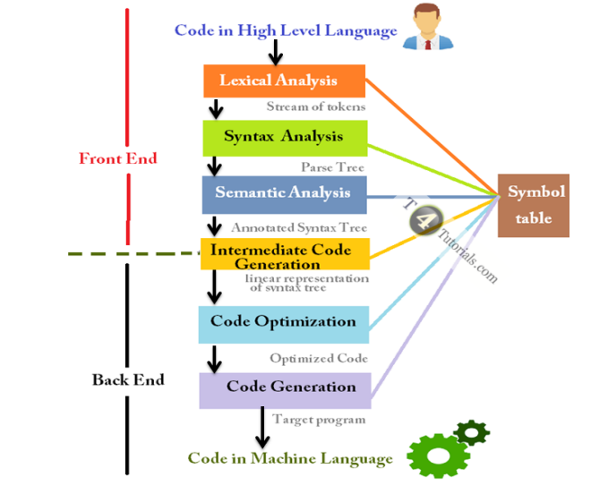
Phases of Compiler
Lexical Analysis (Scanning): This phase involves breaking the source code into tokens.
Syntax Analysis (Parsing): This phase involves analyzing the structure of the source code based on the rules of the programming language's grammar.
Semantic Analysis: This phase checks the source code for semantic correctness.
Intermediate Code Generation: In this phase, the compiler translates the source code into an intermediate representation.
Code Optimization: This phase involves improving the intermediate code to make it more efficient.
Code Generation: This phase translates the optimized intermediate code into the target machine language or bytecode.

Slide 7
Lexical Analyzer
A lexical analyzer, is a program component that breaks down a source code file into a sequence of tokens. It is the first phase of a compiler or interpreter, and its main task is to read the input source code and produce a stream of tokens that can be processed by the next phase of the compiler.

Slide 8
Software Tools
TINY compiler is a simple programming language designed for educational purposes.
Flex Software is a powerful tool for generating lexical analyzers (scanners) for programming languages.
C-Minus Language: is a simple subset of the C programming language, designed for educational purposes.
VSCODE : the editor used for the project

Slide 9
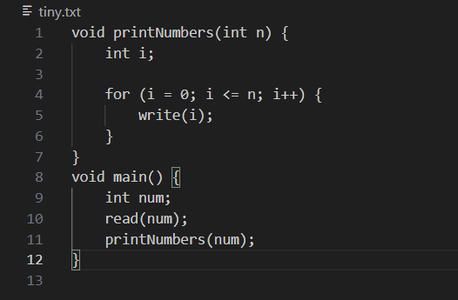
Inputs of Scanner

Slide 10
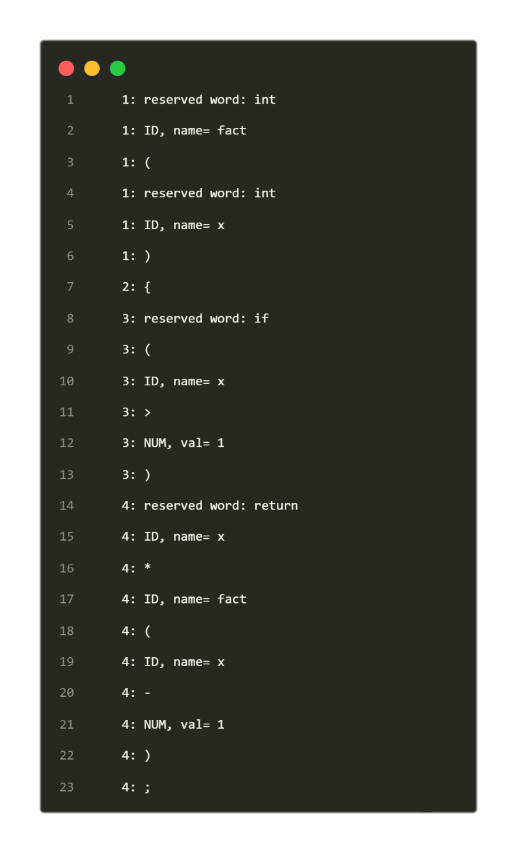
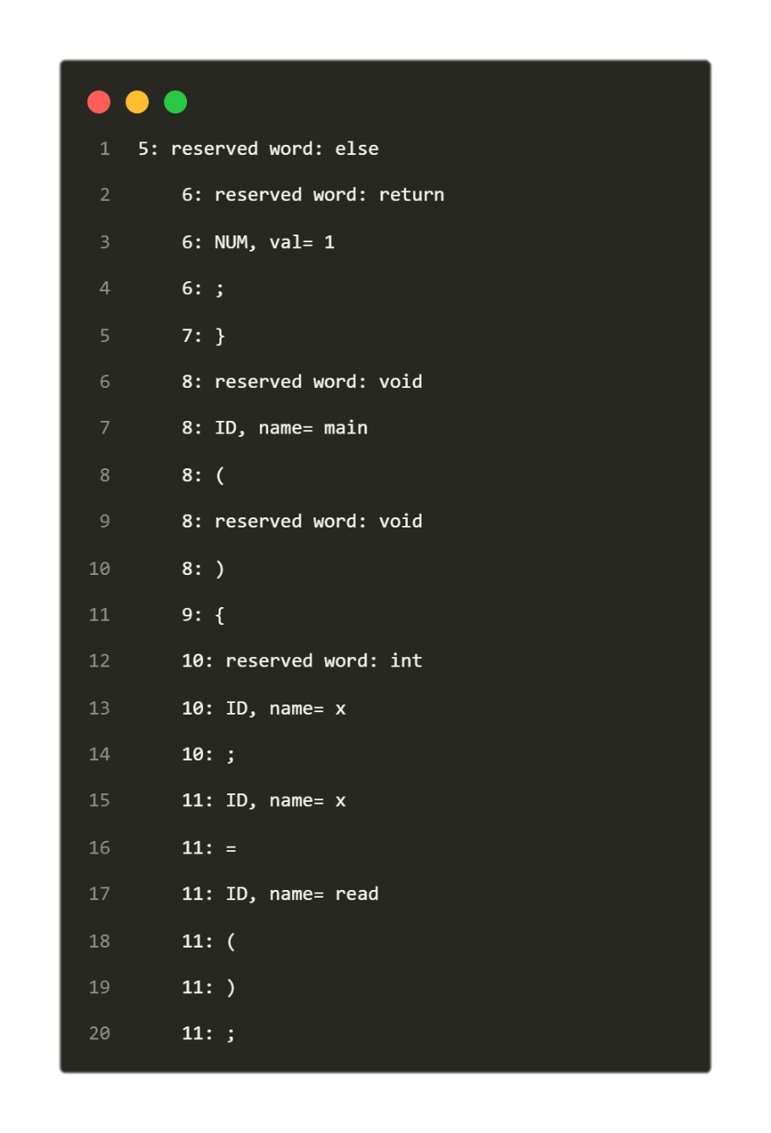
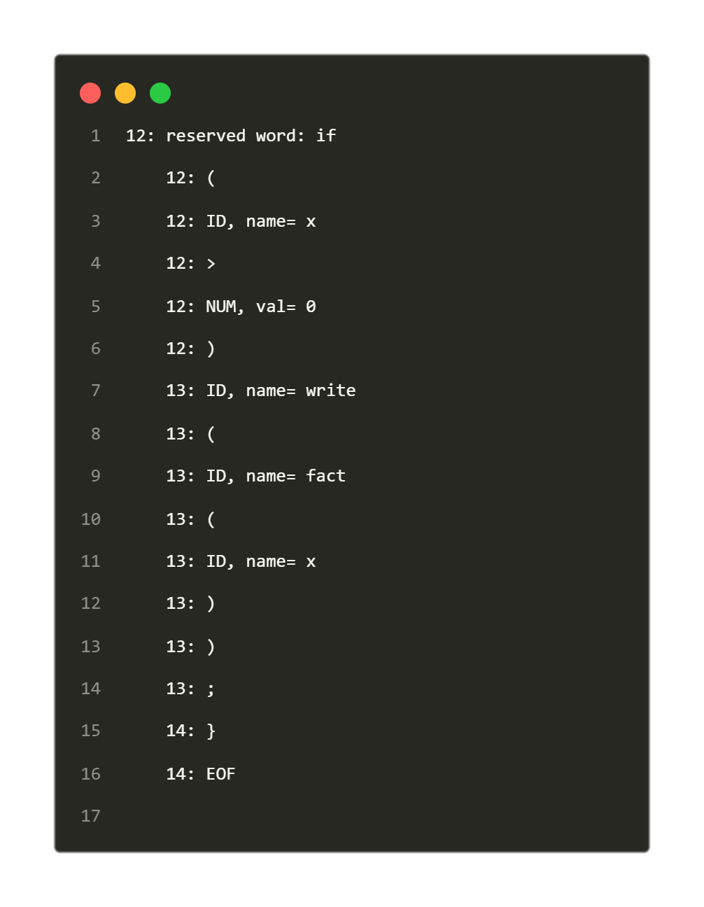
Outputs of Scanner

Slide 11
Conclusion
compilers and lexical analyzers are essential for software development, translating high-level code into machine-readable instructions. Compilers meticulously process code through various stages, ensuring efficient execution across platforms. Meanwhile, lexical analyzers break down source code into tokens, facilitating this process. Together, they enable programmers to express complex logic, driving innovation in the digital sphere.

Slide 12
References
• The book
• Compiler Constructions (Kenneth c. Louden)
• Compilers Principles & techniques and Tools

Slide 13


